Slide 1
Classroom Management & Organization
PACIFIC UNION CONFERENCE
Martha Havens, Associate Director of Elementary
5–8 Multigrade Workshop; Sacramento, CA

Slide 2
General objectives for this session
Management of Students
Components of a Discipline Plan
Rules vs. Procedures/Demonstration
Rewards (Positive Reinforcement First)
Consequences
Behavioral Contracts
Our Life as Educators

Slide 3
Management of students
Definition of Management:
Having authority
The process of engaging people

Slide 4
Components of a Discipline Plan
“If you do not have a plan, you are planning to fail.”
General Classroom Rules
Procedures
Rewards
Consequences
Discipline
RULES

Slide 5
Sample of General Rules
Kindness
Work
Quietness
Cleanliness

Slide 6
Rules are important, but
Procedures Rule
PROCEDURE
ROUTINE = STRUCTURE

Slide 7
Procedures
Consider where you need procedures (well planned procedures are the best plans you’ll have all year!)
Videos of teachers quickly sharing their 3–5 most important/useful classroom procedures that allow for multigrade instruction
Teachers showing what has worked for them for keeping records of attendance, grades, behavior etc.

Slide 8
Sample of Procedures
Responding to an earthquake/fire drills/other alerts
Listening to/responding to questions
Entering/leaving the classroom
Getting to work immediately
When you are tardy
End of period class dismissal
Participating in class discussions
When you need pencil/paper
Checking out classroom materials

Slide 9
Teach Each Procedure as a Lesson
Teacher models/teaches the procedure
A student or the class demonstrate guided by teacher, models the procedure
Practice time for each procedure is given. The teacher decides when to finish practice
Teacher is alert to reinforce
Ask students to evaluate and make changes as needed

Slide 10
Best 6 multigrade Classroom Procedures Worth Teaching
What to do if teacher is busy when I am “stuck”?
Before working time procedures.
During working time procedures.
After working time procedures.
When I’m done with my assignment?
What makes an Independent Worker?

Slide 11
Setting the Stage…
For maybe 2–3 days—or a week!
Prior to starting, send letter home. Explain expectations for your room and why.
Talk about scheduling.
When will books be assigned and why (placement testing).
Be succinct.
Copy principal.
Think about parent night?
Prepare your room, materials, and the students.
Start with the procedure #1 lesson. Go!
Finish with specific positive reinforcement.

Slide 12
Demo by MH and
Volunteer Teachers!
Warning!
If this looks repetitive… it is!

Slide 13
What to do if teacher is busy and I am stuck?
Ask a friend
Look up the teacher’s guide
Skip now, see the teacher later
Do other work
Free table, if open

Slide 14
Working Time Procedures
BEFORE WE WORK
What we are going to do is announced (the task)
Prepare materials for the task or tasks
Choose the best place to do your work

Slide 15
Working Time Procedures
DURING WORKING TIME
Work alone/with a friend or friends
Use the correct voice
Know what to do if stuck with your work

Slide 16
Working Time Procedures
AFTER WORKING TIME
Record what you did if needed
Find a place for your work
See what to do, if you have more time
Clean up your area
Talk to your teacher when available
Brain Break Time!

Slide 17
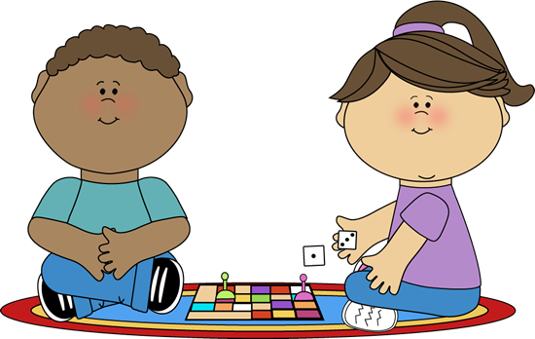
When done with your assignment:
Do more, get ahead
Do other work
Help a friend
Free table, if open

Slide 18
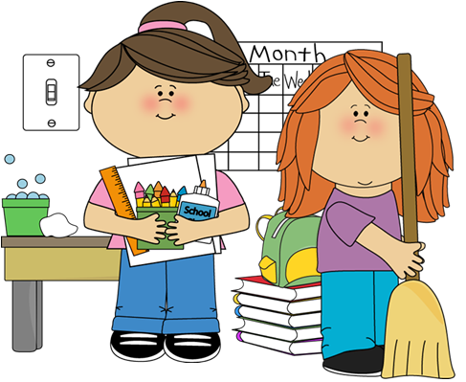
What makes an independent worker:
Knows the job
Gets the materials
Chooses a good place
Works immediately
Keeps records
Picks up

Slide 19
Managing classroom space
Master teachers demonstrate effective design and placement of:
Seating arrangements
Centers
Teacher line of sight
Distribution and collection of materials/assignments

Slide 20
Managing Student Grouping
Demonstrate whole group instruction leading to breaking off grade groups as teacher continues to instruct smaller group.
What to consider when grouping students and when to change groups

Slide 21
Manage Scheduling
This segment should address ways master teachers build and flex their schedules instead of being ruled by the schedule.
Schedule daily activities that are independent and teacher led to facilitate small group and individual instruction.
Vary activity and movement throughout the day
Carefully consider time management procedures for transitions.

Slide 22
Plan Your Classroom Schedule for Procedure Lessons
Worship. A Time for All Things. Eccl. 3:1–8
Then explain to the students your goals, expectations and philosophy… Teamwork/rules/work/rest/fun/why?
Ages, learning styles, interests, grades, brain, etc.
Have them ask questions.
Explain schedule for the next 2–3 days/a week or 2? It all depends how we work.
Questions?
Start with Procedure #1

Slide 23
Manage Consequences
Before They Happen

Slide 24
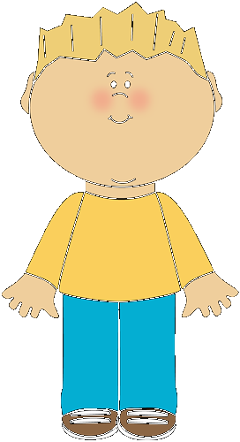
A Word About Rewards
Definition: To give or assign to as due; recompense
Extrinsic
Group
Intrinsic

Slide 25
After Agreeing to Rules and Training to Procedures
“A change of mind may occur.”
Student made a mistake! Forgot temporarily!
Student knows the rule, expectation, but chooses to go against it.
Student has never been in your room before.

Slide 26
Ask yourself these questions before dealing with consequences…
Is it a temporary situation? More in the “Oops, I forgot…” category/garden variety?
Or is it in the category of the second, third repetition? The teacher must now apply the discipline plan/consequences!
Or is this totally unacceptable behavior that does not respond to any of the warnings or the discipline plan, but is consistently occurring? It must stop now rather than allow it to escalate.

Slide 27
You judge this as a temporary situation…
Here are some options:
Move close to the student.
Make eye contact and wait to see if a change occurs.
Give a non-verbal signal to stop behavior (choose signal carefully).
Re-direct the student to appropriate behavior, citing briefly but clearly what activity is expected now.
Call the student/privately give a verbal instruction to stop the behavior.

Slide 28
You judge this as not a temporary situation…
What are the consequences? How do you support student behavior change?
Plan to make up for action/time lost
Time out?
Recess penalties? (philosophy/discussion)
Card system (Lee Canter)
Points system
Tickets (as police give tickets)
Payments to teacher (points, classroom money, etc)
Referrals to office/another room
After school make-up time
Teacher conference/prior to parent conference or call
Sid Simon/Cordwin/Glasser

Slide 29
Types of behavioral contracts:
A Simple Behavioral Contract
A Complex Behavioral Contract

Slide 30
Final thoughts on classroom management and discipline
You are the adult. Maintain dignity. Do not let a student’s problem be in charge of the room; it is already in charge of the student. You be in charge of yourself, the classroom, and your response to the situation.
Respond, do not react, to the situation. The student needs assistance in some way. If you can do that, do it. If you also need assistance, get it. It’s not a big deal. You can not do everything all the time.

Slide 31
We are to take time with the Lord, our families and ourselves. But often we leave the ourselves out! If you love yourself, you will care for you. Think of all the health advice we have and do it!
Learn to prioritize.
Learn to say No!
Learn to delegate.

Slide 32
But above all…
You are not alone!
There is a higher power. Put yourself in His hands!

